Slide 1

Dr.Love
TEAM – 9
TEAM MEMBERS-
Guillermo Romero
Jiwook Chung (Team Leader)
Ankush Mittal
Ning Su

Slide 2

INTRODUCTION
Dr. love is an windows form interface developed by our team in order to help people overcome their loneliness.
This application will allow the user to create his or her profile in which they can include their personal information.
The application will search for the appropriate matches for the user from a database.

Slide 3

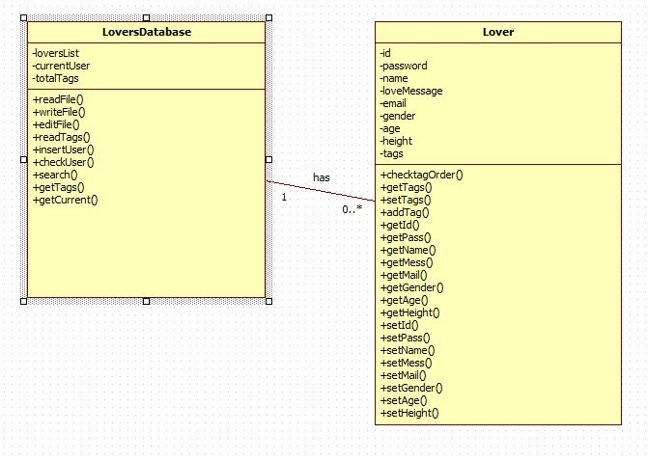
CLASS DIAGRAM

Slide 4
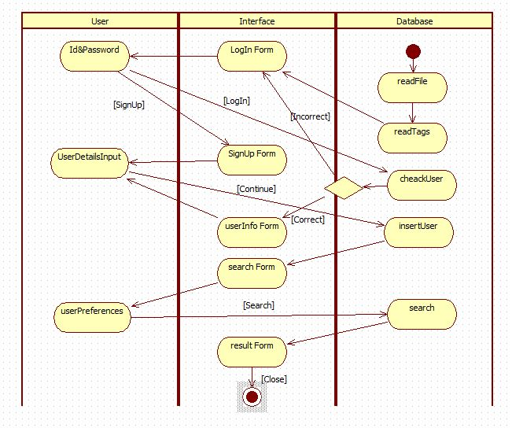
ACTIVITY DIAGRAM

Slide 5

LETS FIND YOUR MATCH !!

Slide 6


